Slide 1

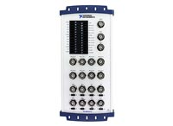
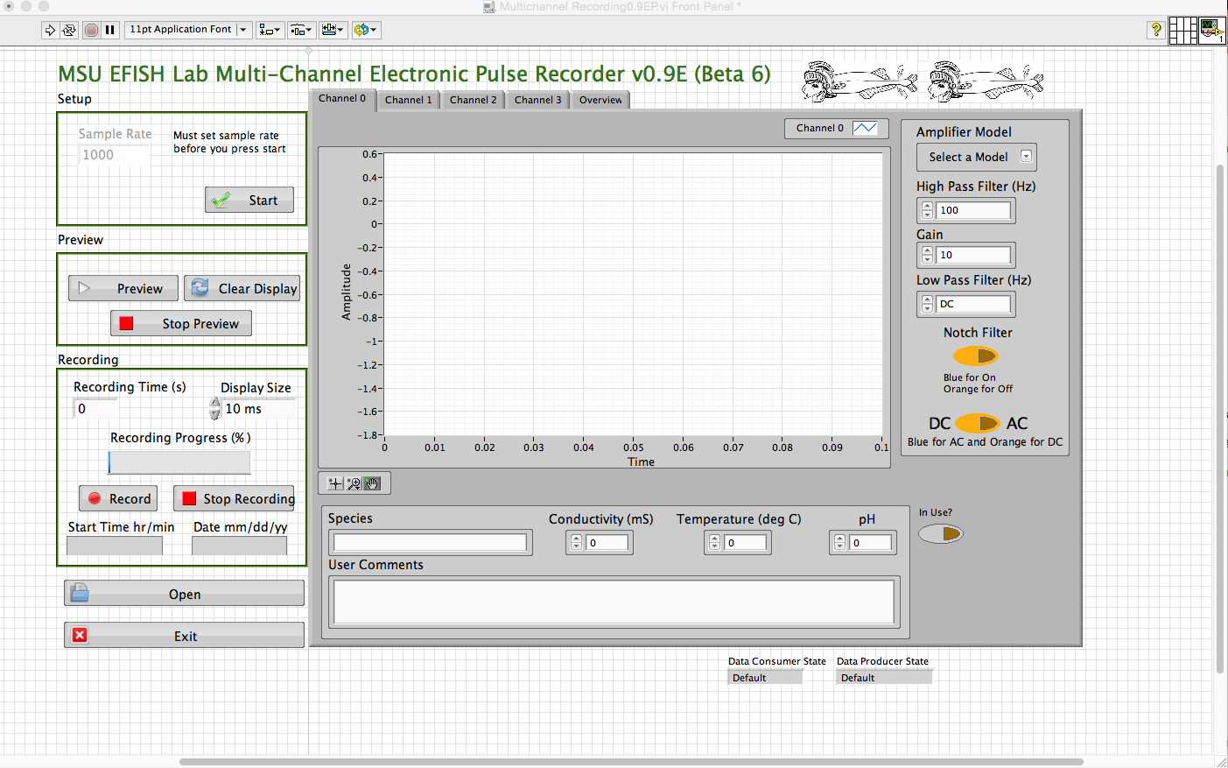
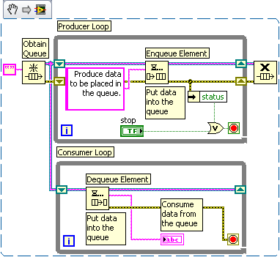



LabVIEW Based Software for Recording Electric Organ Discharges from Weakly Electric Fish
Adam Gleichman and Jason Gallant
Electric Fish Lab • Departement of Integrative Biology• Michigan State University
Abstract
Methods
Results & Discussion
Mormyrid fish produce electric organ discharge (EOD) pulses in water with a specialized electric organ, which is used in communication and navigation. To better understand the behavior of these fishes, accurate recordings of their EOD behavior are critical. We developed software with the goal of recording these electrical organ discharges (EODs) over a long period of time with a high resolution and with limited hardware capabilities. Using LabVIEW (National Instruments software), we developed a software program capable of recording and visualizing EOD behavior in real time. The recorded data needs to be recorded into some type of storage to be display again in the future with a large amount of data points. The user needs a display for the data in real time while the recording is in process. The program needs to be user friendly because most users will come from a non-programming background. Due to limited hardware capabilities, the program needs to be robust to handle possibly large amounts of data collected for long periods of time or really large sample rates for a moderate amount of time. This software will enable any one with limited hardware to graph and discover weaker electric organ discharges in higher resolution.
Software: LabVIEW 2014 with DAQmx-base library
Hardware: Macbook pro and air with an National Instruments Data Acquisition board USB-6211 and USB-6216
Set up for Data Acquisition:
<insert picture of the fish tank>
Solutions
- we chose LabVIEW for our programming language because of its ability for parallel task handling and for its compatibility with MAC OS, Windows, and Linux
- The solution to the accurate timing was to set the speed of the internal sample clock that is inside the NI boards and ask for a set about of data that would be in 0.1 of a second then count the amount of times the program read the data until it reaches the amount of time that the user wants
- Data is recorded in .tdm / .tdms file format because of how well it pairs the metadata and data from the board and it is efficient
- The DAQmx-base libraries for LabVIEW were able to read voltage from the BNC cables that connect the amplifiers to the DAQ board
Programs Created
-Single Channel Recording
=records voltages to .txt file with graphical display of voltage over time
(What type of Set ups you were programming for)
<insert the photos>
What we functions wanted to make:
- Single Channel Recording
-Multiple Channel Recording
-Voltage Trigger
-Single Waveform Recording
Priorities
1. Single Channel Recording
2. Multiple Channel Recording
3. Scheduled Recording
-Voltage Trigger
-Single Waveform Recording
Program Features
Architecture
Credit to LabVIEW Wiki
Courtesy of ni.com
Courtesy of ni.com
Real Time Display
With the display showing what the DAQ (data acquisition) board is reading in real time will help users to diagnose hardware issues because the data they see is raw and not edited to look like something they would expect.
Recording for a Given Amount of Time
This allows for the user to easily scale up or down the amount of time depending on what they need for their experiments.
Ability to Open .tdms Files
Files with the extension of .tdms are part text and part binary, so an ordinary computer can not just open these files without a special program or plugin for Windows Excel. Because of this, a .tdms open function was added so anyone can open up previously made files without having to install more software.
Work with Meta Data from the User
All files recorded by the user will also record the settings the user inputs inside the tab function such as: species, comments, ext. This eliminates possible mismatching of meta data with recorded voltage data.
Records up to 4 Channels
Simultaneous recording allows for better data between a control group and experimental group because the recordings are at the same time.
Rolling Display
A rolling display displays the most recent data in a specific amount time specified by the user. By not stacking data history, the data is easier to look at over long periods of time and the display will not slow down the recording.
The basic model of the program architecture is a double producer consumer setup. Producer/Consumer structures have the benefit of being able to handling data streams and user events with great efficiency. With two Producer/Consumer loops running in parallel, the program easily handle both gathering and recording data with responding to the user pressing buttons to to signal a new event. If you have more specific questions just ask me, I will have the code printed with me on hand.
Objectives
Future Directions
What is needed from the software
- the ability to record voltage levels from amplifiers that were connected to the fish tank set ups (pictures in the Methods Section)
- pair meta data from the user with a recording (ex: fish species, temperature, comments, etc..)
- keep accurate timing
handle sampling rates of greater than or equal too 100,000 samples per second
- display of data for the user to see if there is a problem with the hardware
- compatibility with MAC OS, Windows, and Linux
- work with National Instruments data acquisition boards
- user friendliness
Increase the modularity and efficiency of the multiple channel recording software
Finish the scheduled recording, voltage trigger, and single waveform functions
Find a way to replicate an oscilloscope triggering mechanism for recording single waveforms
Stronger error handling
Scale up the Multiple Channel software for 8 channels
Possible advancement to an open source programming language
Use the voltage reading to calculate position of fishes for studying behavior
Acknowledgments
(Ideas: thanks to the NI help desk, NSF, MSU, Professor Gallant,)
Credit to msu.edu

